Slide 1

Superstore Sales Analysis & Forecasting
Interactive Insights and Predictive Analytics with Power BI
Nibedita Sahu
Data Science & Analytics

Slide 2
Objective
This report aims to analyse the sales performance of a retail superstore, identify key trends and patterns across regions, segments, categories, shipping modes, and forecast upcoming sales for the next 15 days.
The goal is to uncover actionable insights that drive better business decisions through data visualization and time-series forecasting.

Slide 3

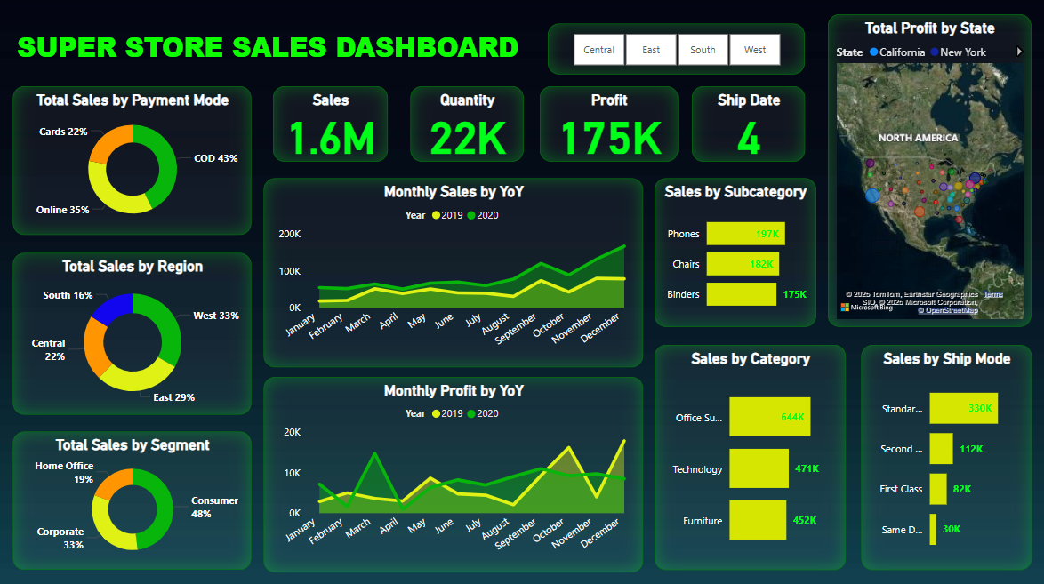

Slide 4
Main Report Structure
The report provides an integrated perspective of sales performance across multiple business dimensions:
KPIs like Sales (1.6M), Quantity Sold (22K), Profit (175K), and Number of Ship Dates (4).
Sales Distribution by Region, Segment, and Payment Mode (Donut charts).
Time-based Trends shown using YoY comparison for Monthly Sales and Monthly Profit.
Category-Level Breakdown including:
Top Performing Subcategories: Phones (197K), Chairs (182K), Binders (175K)
Category-Wise Sales: Office Supplies, Technology, Furniture
Shipping Preferences: Standard (330K), Second Class, First Class, Same Day
Map Visualization showing Profit by State, highlighting states like California and New York as top contributors.

Slide 5
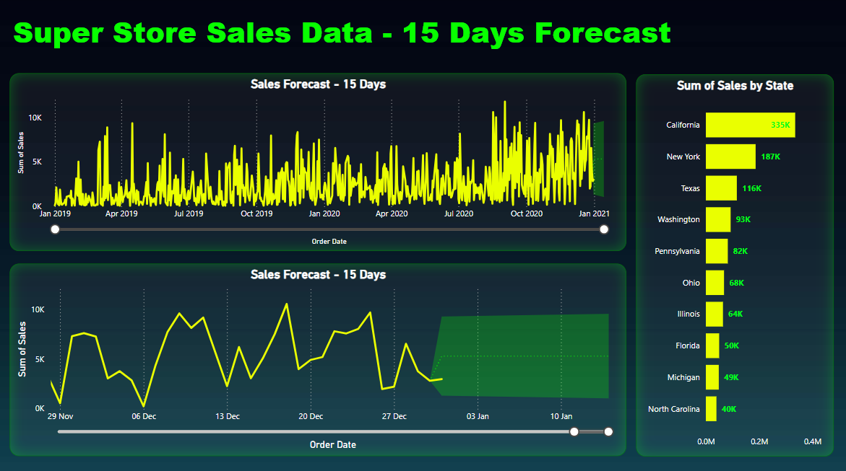

Slide 6
Forecast Structure – 15 Days
The Forecasting tab uses historical sales data from Jan 2019 to Dec 2020 to predict the next 15 days of sales (Jan 2021).
It consists of a single forecast line chart, represented in two zoom levels:
The top chart provides a full-length trend view over the entire time span (for pattern visibility).
The bottom chart zooms in on the most recent few weeks, including the 15-day forecast zone, making the trend clearer and easier to interpret.
The bar chart beside highlights state-wise performance with California (335K), New York (187K), and Texas (116K) as the leading contributors (Only the Top-10 states are displayed for clarity and focus).
The dual zoom approach ensures users see both the big picture and the actionable short-term forecast. And the state-wise breakdown quickly identifies high-performing regions, supporting targeted decision-making.

Slide 7
Key Metrics
Metric | Value | Insights
Total Sales | 1.6M | Reflects strong revenue generation across all regions.
Quantity Sold | 22K | High product volume suggests steady demand.
Total Profit | 175K | Profitability margin indicates efficient cost control.
Average Delivery Time | 4 Days | On average, orders are shipped within 4 days of being placed.
The last one calculates the difference in days between the Order Date and the Ship Date for each order. Here, it's 4, which means on average, it takes 4 days from when an order is placed to when it is shipped.

Slide 8
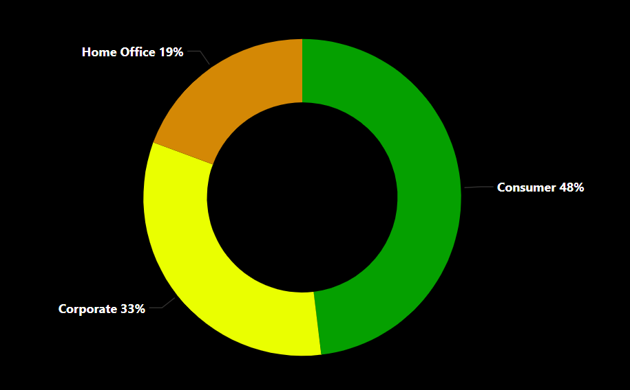
Total Sales by Segment
Consumer segment leads in sales (dominating 48% alone, nearly half of total sales), followed by Corporate (33%) and Home Office (19%). This shows individual customers are our main buyers.

Slide 9
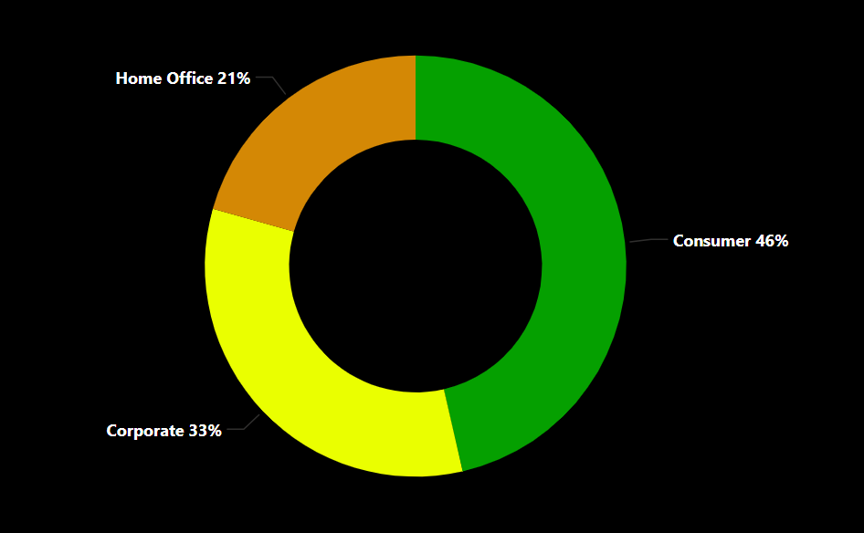
Total Profit by Segment
Despite high sales, the Consumer segment (46%) also shows the highest profit, making it both the revenue and profit driver.

Slide 10
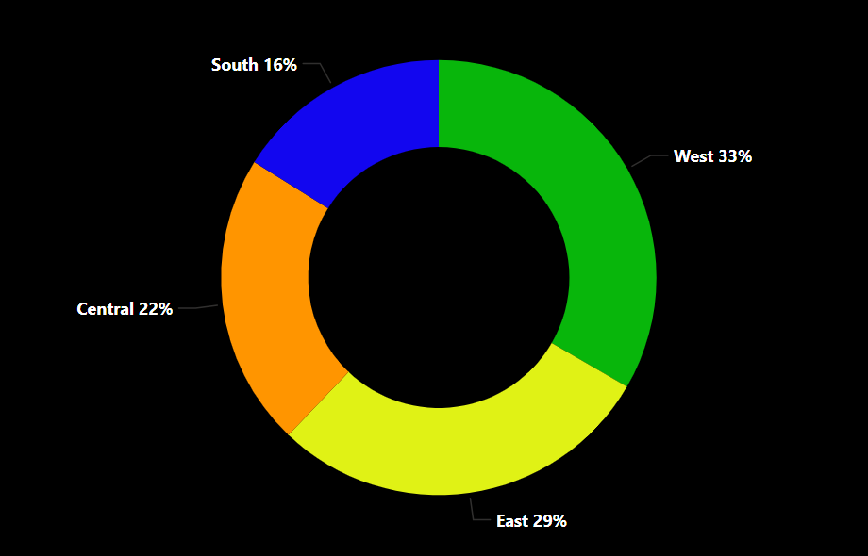
Total Sales by Region
West leads sales (33%), followed by East (29%) and Central (22%). South lags at 16%, highlighting growth potential in that region.

Slide 11
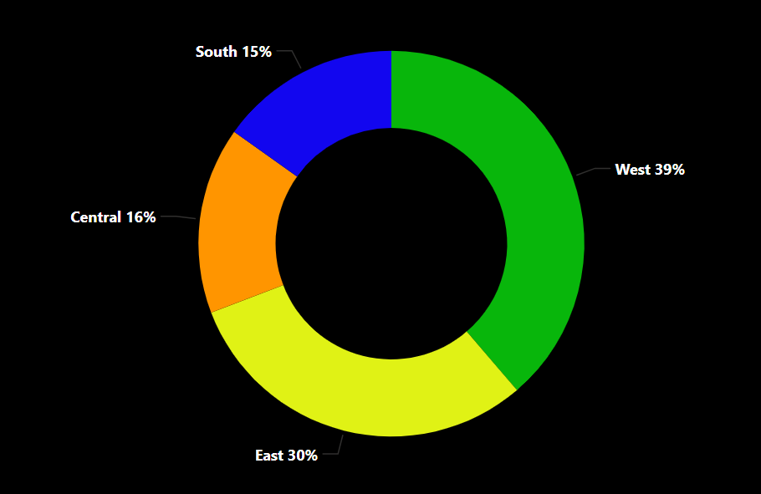
Total Profit by Region
West (39%) and East (30%) lead in profit as well. While, Central (16%) and South (15%) regions show relatively low profits, indicating higher costs or inefficiencies.

Slide 12
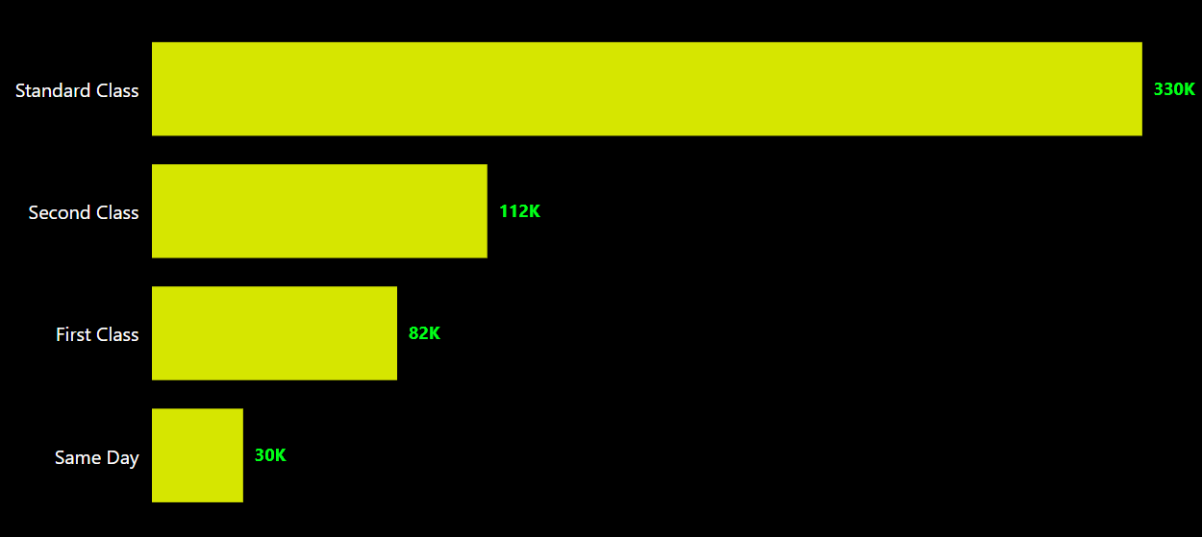
Total Sales by Ship Mode
Standard Class (330K) leads in sales, followed by Second Class (112K) and First Class (82K), while Same Day contributes the least. This highlights customer preference for standard shipping options.

Slide 13
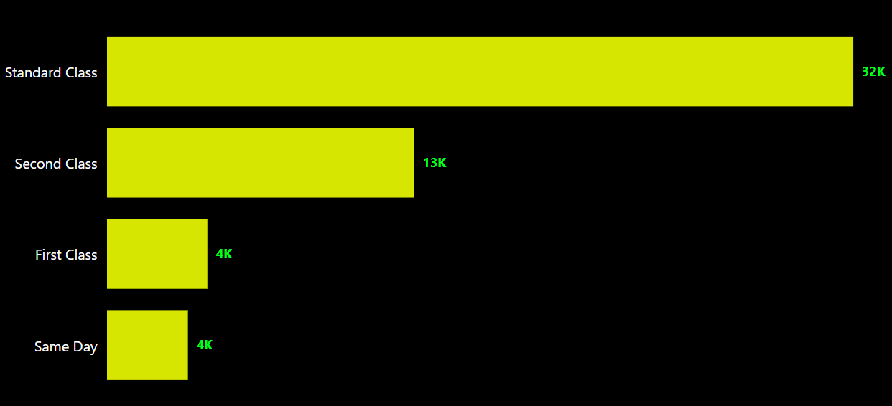
Total Profit by Ship Mode
Despite generating the highest sales, Standard Class (32K) brings in the most profit. However, all shipping modes show relatively low margins, suggesting shipping costs may drag down overall profitability.

Slide 14
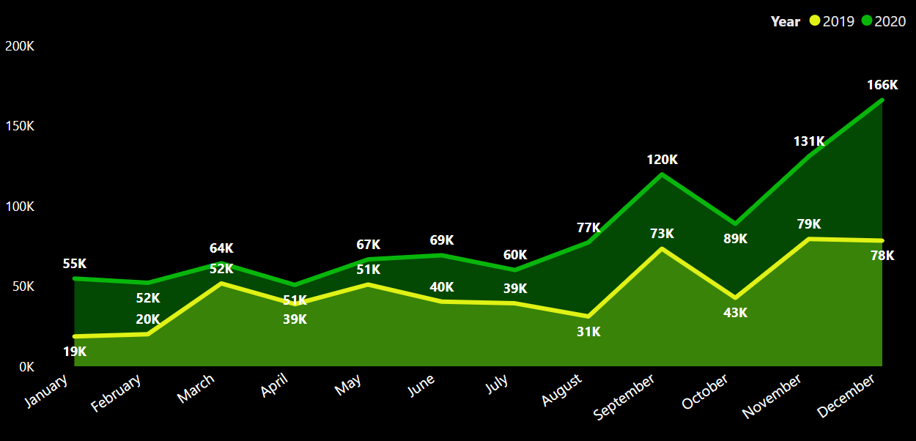
Total Sales by YoY
2020 sales peak in December (166K), far exceeding 2019 (78K). Sales took off starting in September, driving a significant jump from the previous year. This year-over-year growth highlights improved performance over time.

Slide 15
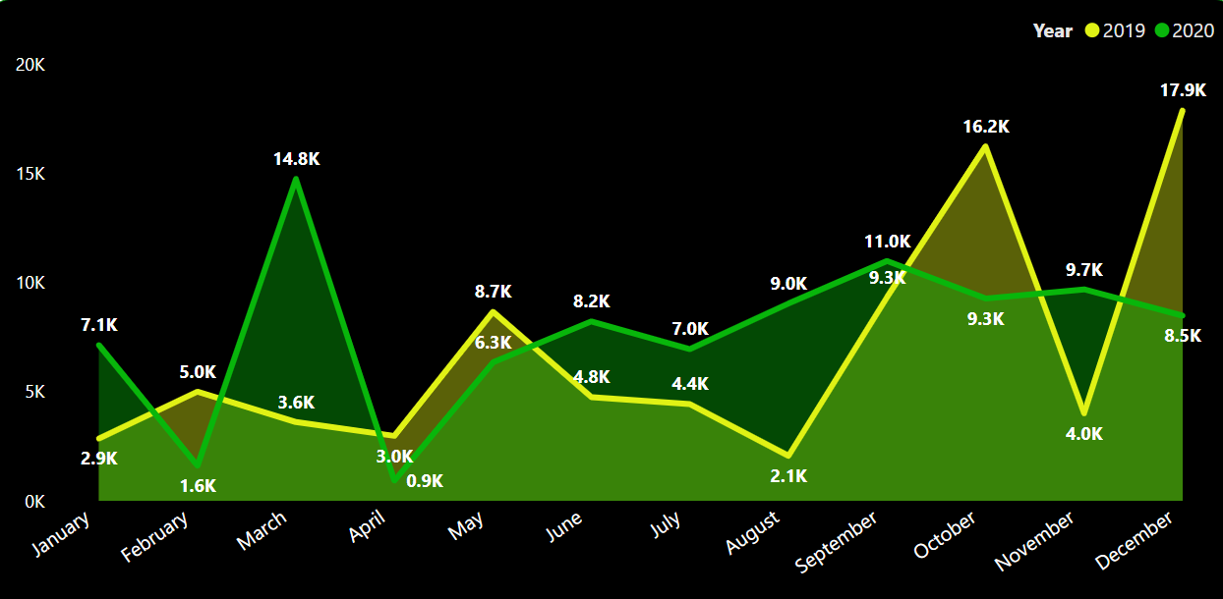
Total Profit by YoY
Despite sales growth, 2020 profits lag behind 2019 in key months like October (9.3K vs. 16.2K) and December (8.5K vs. 17.9K). While some months show improvement, overall profitability remains a concern.

Slide 16
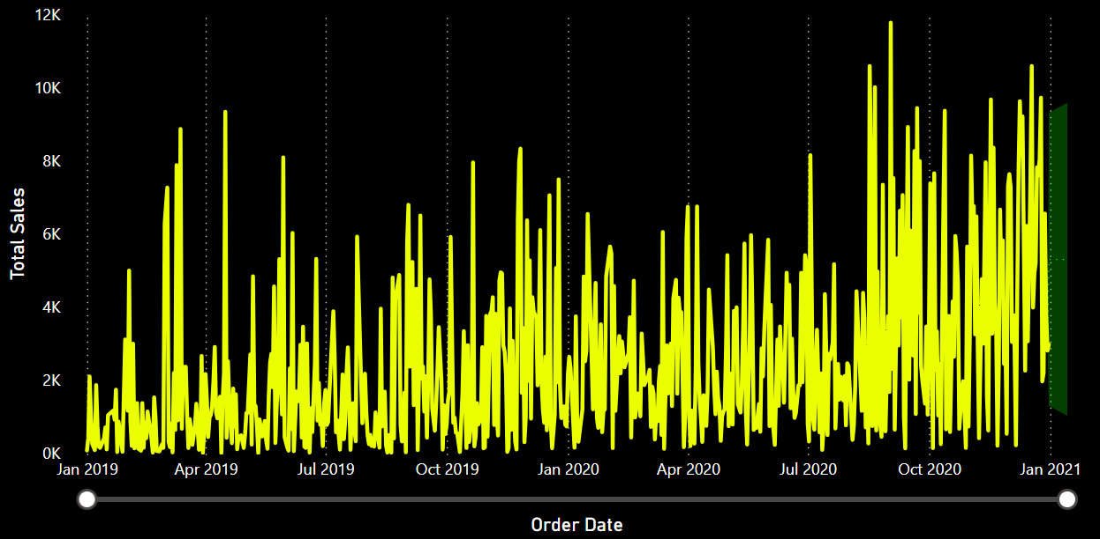
15-Day Forecast – Zoomed Out
The overall forecast suggests a steady upward trend in sales. Seasonality appears minimal. Let's zoom in for a closer look at this promising sales outlook.

Slide 17
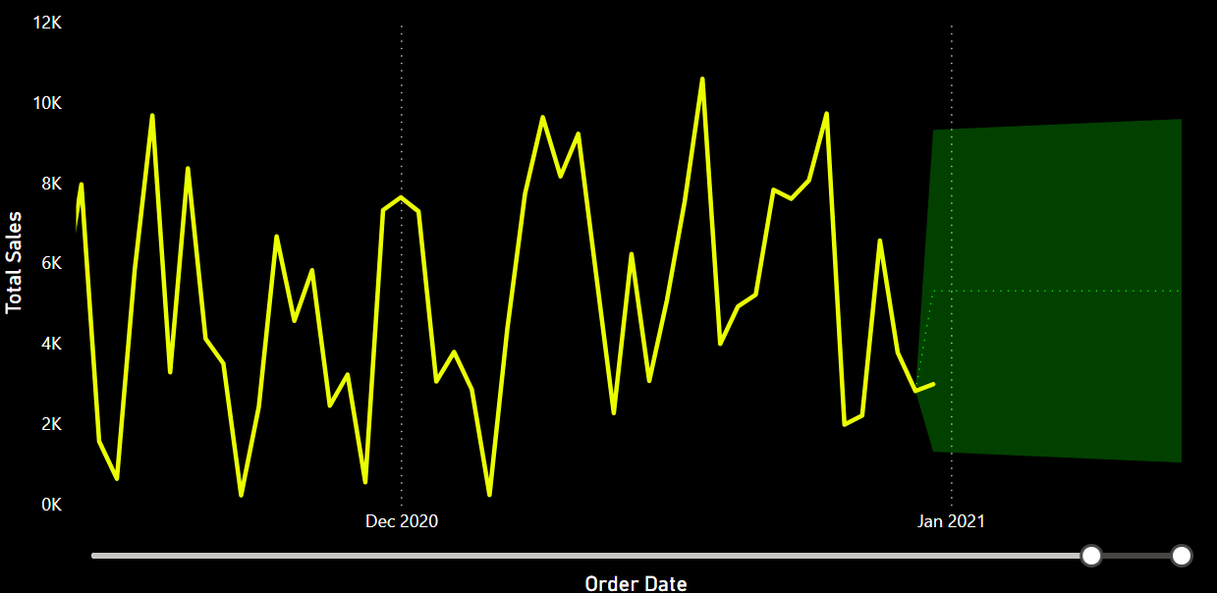
15-Day Forecast – Zoomed In
Zooming in confirms the upward sales pattern. With no major fluctuations expected, it's an ideal time to launch targeted campaigns to maximize revenue.

Slide 18
Insights
Consumer segment dominates both sales and profit, especially in the West and East regions, making them high-priority markets.
The West and East regions dominate both sales and profits, contributing over two-thirds of the total, while the South lags significantly in sales and profitability. This shows that the South and Central regions have room to grow and need to improve how they manage costs.
Standard Class sees the highest usage and profit, but across all shipping modes, profit margins are way too low compared to sales. High shipping costs may be dragging down overall profitability, indicating a cost-benefit analysis.
Despite a strong sales surge in late 2020, with December sales more than doubling compared to 2019, profitability did not keep pace-key months showed lower profits despite higher revenue. This indicates that while revenue growth was achieved, underlying cost or margin issues limited overall financial performance.
The 15-day sales forecast exhibits a wide confidence interval, indicating potential short-term fluctuations. Close monitoring and flexible strategies are essential for effective resource allocation, demand planning, and stock management.

Slide 19
Recommendations
Focus on the Consumer Segment and Key Regions: Prioritize marketing and promotional efforts toward the Consumer segment, especially in the West and East regions, to maximize revenue and profitability.
Expand in Underperforming Regions: Design targeted campaigns and partnerships in the South and Central regions to unlock untapped potential and drive balanced regional growth.
Optimize Shipping Strategies: Re-evaluate shipping costs and negotiate better logistics partnerships to improve profit margins, particularly for Standard Class deliveries.
Address Margin Pressures: Implement tighter cost controls during high-sales periods to ensure revenue gains translate into higher profits, not just top-line growth.
Be Ready with Forecasted Trends: Monitor short-term sales fluctuations closely and adopt flexible inventory and staffing strategies to quickly adapt to changing demand patterns.

Slide 20

Thank you
Nibedita Sahu
That’s a wrap up — now let’s talk data!

